Slide 1


Functional Annotation Hands-On Most Ever Fun Session
Tanya Berardini, Monica Munoz-Torres PAG XXVII San Diego, CA 13-Jan-2019

Slide 2
Tonight’s plan
Primer on Annotation
Joint Group Exercise 1 (A. thaliana example)
Joint Group Exercise 2 (C. elegans example)
Hands-on Annotation

Slide 3
Primer on Annotation
Overview
Functional Annotation
Controlled Vocabularies
Applications
Notes:
Overview (Tanya)
Who are we?
What is biocuration?
Functional Annotation (Leonore)
Controlled Vocabulary Annotation(Leonore)
What is a controlled vocabulary (CV) annotation?\
What is an ontology?
GOAT basics
ORCID to login
Play with tool (5 mins)
Applications/Why CV annotations are great (Moni)
Term enrichment
Cross-species queries
Computable representation of biology

Slide 4
Who are we?
PhDs in biological sciences
Tanya Berardini: annotation of gene function, development of controlled vocabularies, community support and engagement
Moni Munoz-Torres: genome curation, structural annotation, curation software development

Slide 5
Phoenix Bioinformatics
Non-profit organization founded in 2013
Mission:
integrate, organize, and share data
promote data resource sustainability
foster interaction and collaboration among scientists

Slide 6
Monarch Initiative
Our goals include integrating, aligning, and re-distributing cross-species gene, genotype, variant, disease, and phenotype data.
We develop informatics tools and use computational reasoning to enable phenotype comparisons both within and across species.
We are driven to truly integrate biological information using semantics, and present it in a novel way, leveraging phenotypes to bridge the knowledge gap.

Slide 7
Goals
Education (on biocuration)
Collaboration (with fellow scientists)
Contribution (to the body of integrated, computable knowledge)
Fun!

Slide 8
What is biocuration?
The collection, annotation, and validation of knowledge disseminated through biological databases.
Areas: gene and protein structure, gene function, allele, phenotype, sequence variation, nomenclature, etc.
Notes:
collects, annotates, and validates information that is disseminated by biological (https://en.wikipedia.org/wiki/Biology) and model Organism Databases (https://en.wikipedia.org/wiki/Model_Organism_Database).

Slide 9
Primer on Annotation
Overview
Functional Annotation
Controlled Vocabularies
Applications

Slide 10
Functional Annotation
Assembly:
Genome
Transcriptome
Predicted DNA / Protein Sequences
Examples:
InterProScan
PANTHER Term Enrichment Tool
TAIR, powered by PANTHER
Compare against databases
Relying solely on sequence similarity
Build protein and domain profiles, then run sequence similarity analysis
Enrichment analysis (expression data)
Functional assignments
Gene Ontology, Uberon anatomy (or stage) Ontology, Chemical Entities of Biological Interest, Kyoto Encyclopedia of Genes and Genomes (KEGG), OrthoDB, Benchmarking Universal Single-Copy Orthologs (BUSCO), etc.

Slide 11
Functional Annotation
Gene summary
Gene nomenclature
Biological ontologies
Function/process/subcellular component
Anatomy/developmental stages
Alleles
Phenotypes

Slide 12
Primer on Annotation
Overview
Functional Annotation
Controlled Vocabularies
Applications

Slide 13

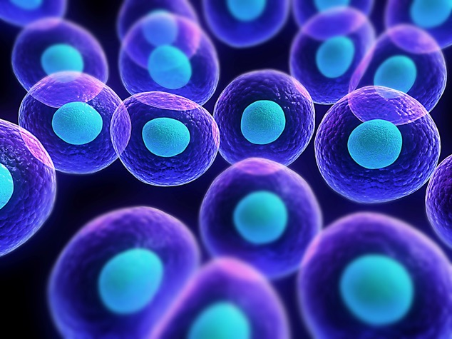
Language inconsistencies in biology
The same name for two different concepts
Cell
or

Slide 14
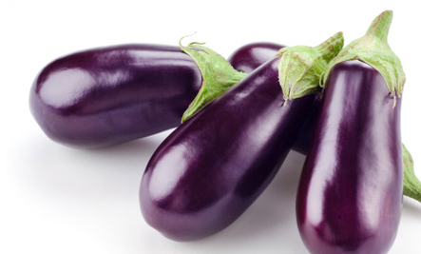
Language inconsistencies in biology
Two or more different names for the same concept
Eggplant
Brinjal
Aubergine
Melongene
The same is true for biological concepts:
This makes comparisons difficult, specially when comparing across species or databases.

Slide 15
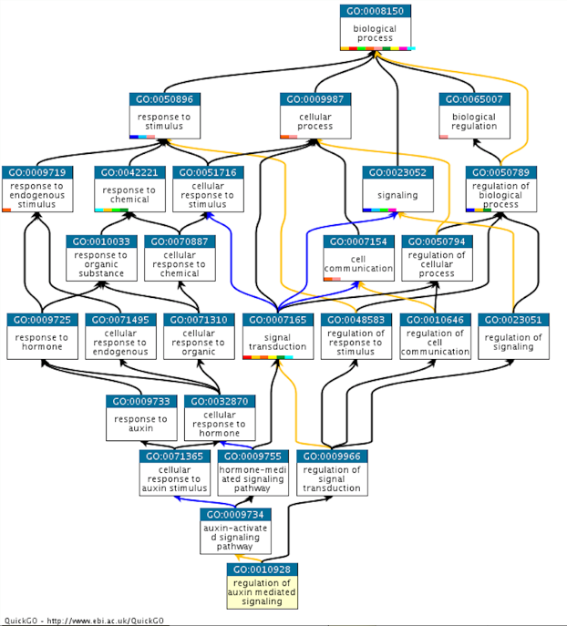
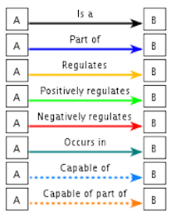

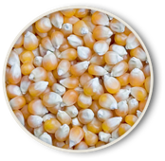
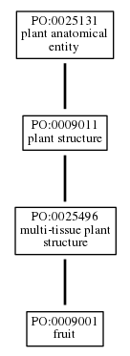
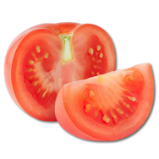
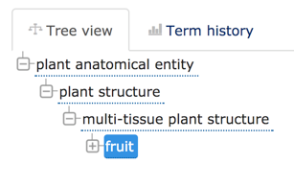

Ontology
An ontology is a set of organized concepts and their relationship to each other; ontologies are usually limited to specific knowledge domains.
Plant Ontology
Gene Ontology
Notes:
Define ontology
-hierarchy (Simple tree vs very DAGGY tree)- EBI view / AmiGO view
Point is that ontologies capture more than just vocabulary, there are relationships that accurately reflect biological knowledge and empower search and analytics.

Slide 16
Gene Ontology
Cellular Component
Molecular Function
Biological Process

Slide 17
Anatomy Ontologies
Animal structures
Plant Structures
Plant Developmental Stages
Uberon
Plant Ontology (PO)

Slide 18
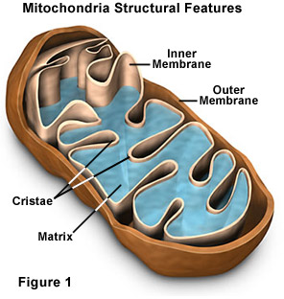
Cellular Component
Where a gene product acts.

Slide 19
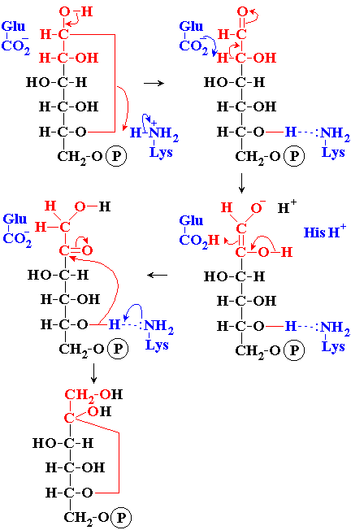
Molecular Function
Activities or “jobs” of a gene product.
glucose-6-phosphate isomerase activity

Slide 20
Molecular Function
A gene product may have several functions.
A function term refers to a single reaction or activity, not a gene product.
Sets of functions make up a biological process.

Slide 21
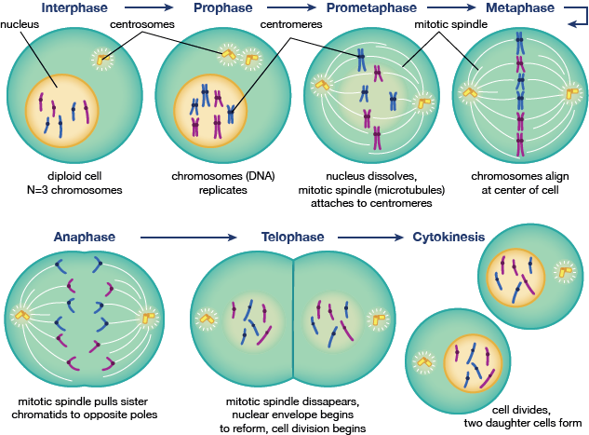
Biological Process
A commonly recognized
series of events.
cell division
ya-webdesing.com

Slide 22
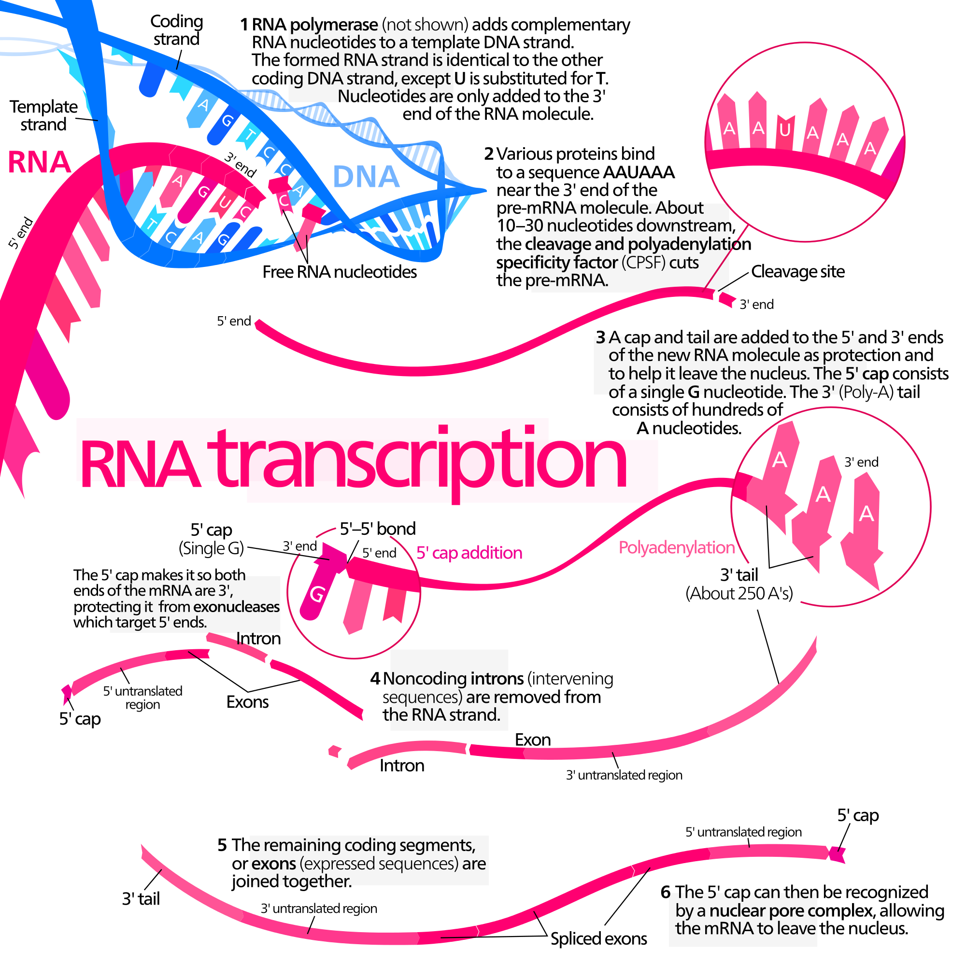
Biological Process
Transcription
Wikimedia Commons

Slide 23
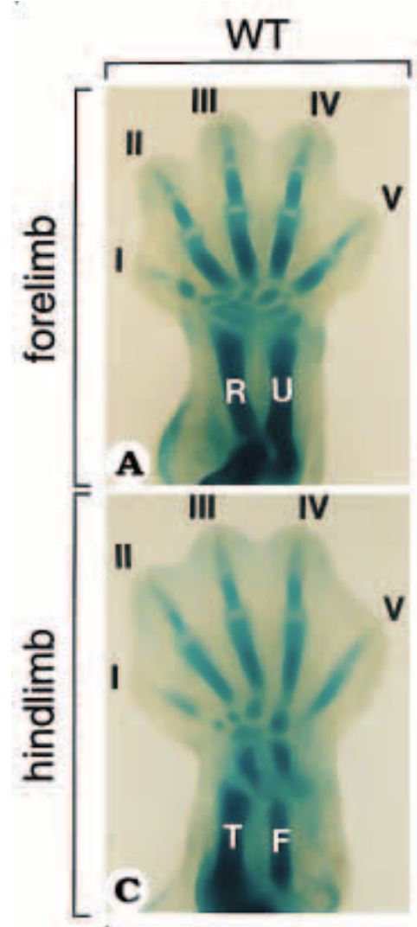
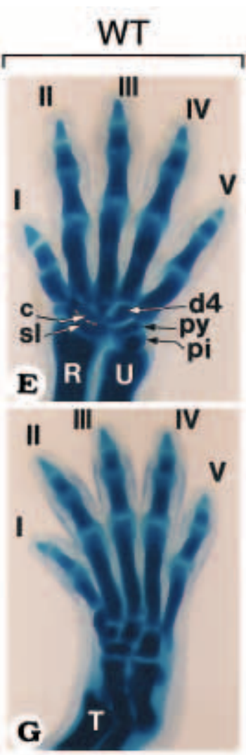
Biological Process
Limb development

Slide 24
Ontology Annotations
These are not ‘attached keywords.’
These annotations are an assertion about a gene product (in this case) that is supported by traceable evidence.
Object (e.g. protein)
NOG1
Attribute
(ontology term)
Root
Evidence
RNA seq evidence
Reference
PMID: 28835689

Slide 25
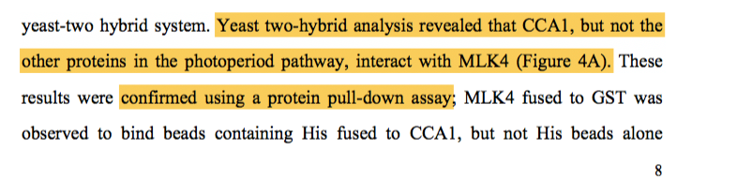
Example
A GO annotation is a statement that a gene product:
has a particular molecular function or is involved in a particular biological process or is located within a certain cellular component
as determined by a particular method
as described in a particular reference

Slide 26
To Keep in Mind
When making functional annotations for genes
Choose primary research articles, not reviews
Verify experimental design, organism, and results
Find the identifier for the gene(s) in question in the paper
Look at the results section, aim for the figures and tables
Use the most granular terms possible
Notes:
What to look for in a paper? What makes a paper *good* for functional curation?…… e.g. understanding if / when to annotate phenotypesNOT high throughput papers!

Slide 27


Evidence Codes
Inferred from Electronic Annotation (IEA)
Inferred from Sequence or structural Similarity (ISS)
Inferred from Genomic Context (IGC)
Inferred from Biological aspect of Ancestor (IBD)
Inferred from Key Residues (IKR)
Inferred from Rapid Divergence (IRD)
Inferred from Reviewed Computational Analysis (RCA)
Traceable Author Statement (TAS)
Non-traceable Author Statement (NAS)
Inferred by Curator (IC)
No Biological Data available (NBD)
Inferred from Direct Assay (IDA)
Inferred from Physical Interaction (IPI)
Inferred from Mutant Phenotype (IMP)
Inferred from Genetic Interaction (IGI)
Inferred from Expression Pattern (IEP)
http://geneontology.org/page/guide-go-evidence-codes
Notes:
Evidence codes and evidence hierarchy. 3 broad categories 1) Computational Evidence Codes ,2) Author/Curator Statements and 3) Experimental Evidence Codes which are the ones we will primarily be using here.

Slide 28
Primer on Annotation
Overview
Functional Annotation
Controlled Vocabularies
Applications

Slide 29
Applications
“Term enrichment”
Cross-species queries
Computable representation of biology

Slide 30
Functional Annotation Classification, enrichment, over/under-representation
List of genes or proteins with associated functional classification from a database: Gene Ontology, PANTHER Protein Class, Reactome Pathway, OrthoDB, KEGG, etc.
A list of genes or proteins is compared to a reference list to statistically determine over- or under-representation of the selected ontology categories among genes/proteins in the list.
Enrichment: A list of genes or proteins with expression data (gene expression, protein expression, etc.), is evaluated to assess likelihood that numerical values of genes associated with a particular ontology term were drawn randomly from the overall distribution of values.

Slide 31
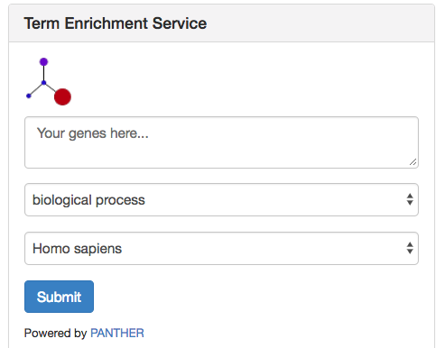

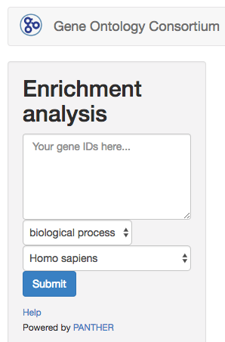
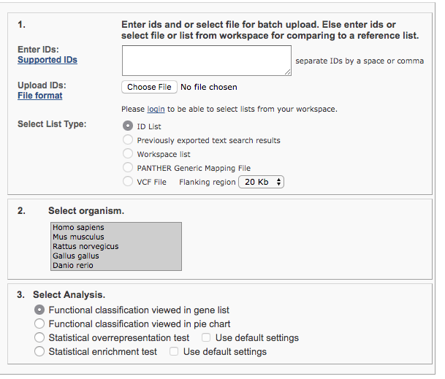

Term Enrichment
For MODs
http://geneontology.org/page/go-enrichment-analysis
Ontology
Species
http://amigo.geneontology.org/
Powered by
http://www.pantherdb.org/
http://GeneOntology.org/

Slide 32
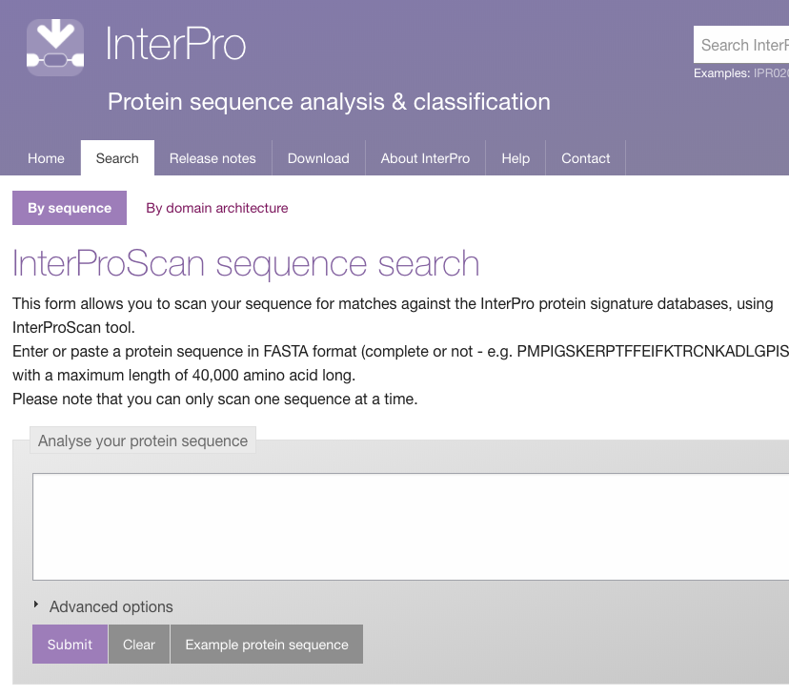

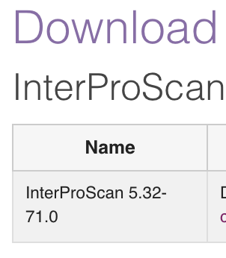
Functional Assignment by Sequence Similarity in the context of evolutionary history
MODs & no-MODs
InterProScan
Predicts GO terms based on detected domains using a mapping file, InterPro-2-GO, one sequence at a time.
http://geneontology.org/page/download-mappings
http://www.ebi.ac.uk/interpro/search/sequence-search
https://www.ebi.ac.uk/interpro/download.html

Slide 33
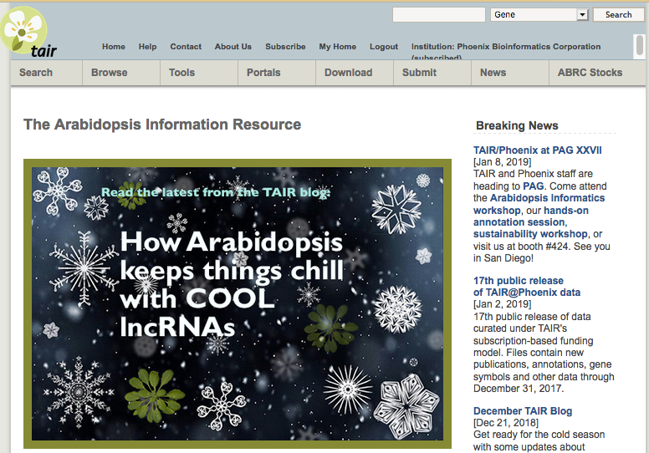


Term Enrichment at The Arabidopsis Information Resource (TAIR)
Powered by
http://www.pantherdb.org/
https://www.arabidopsis.org

Slide 34


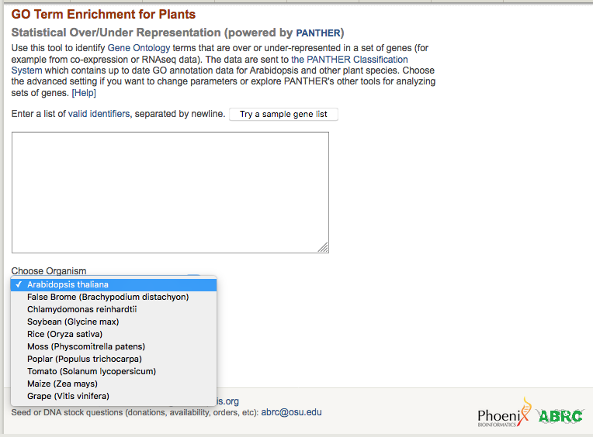
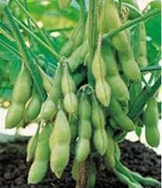
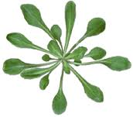
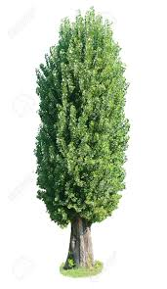
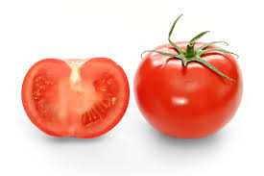
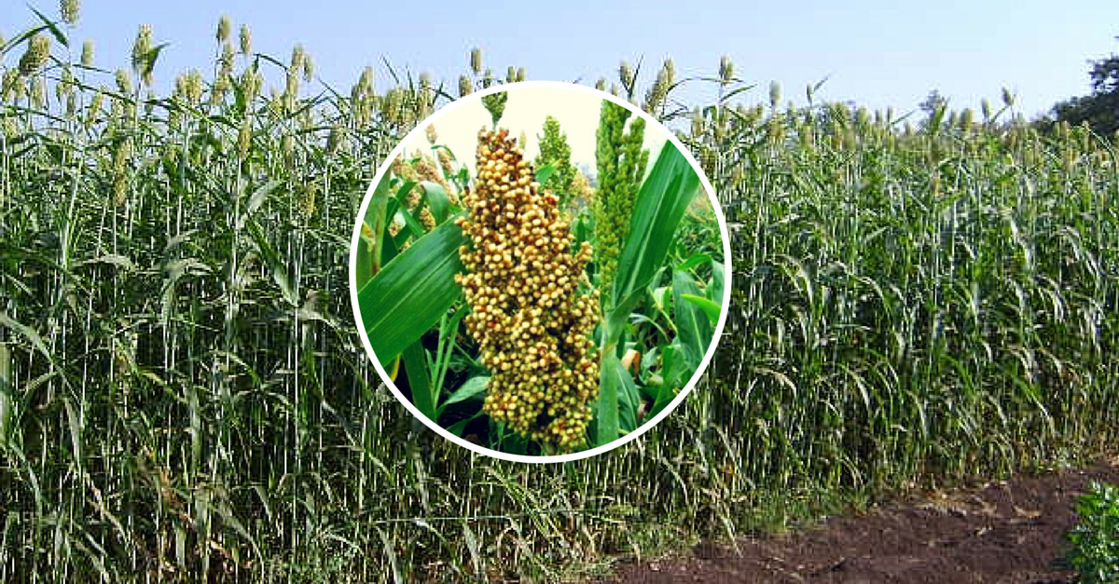
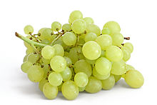
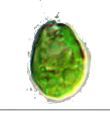

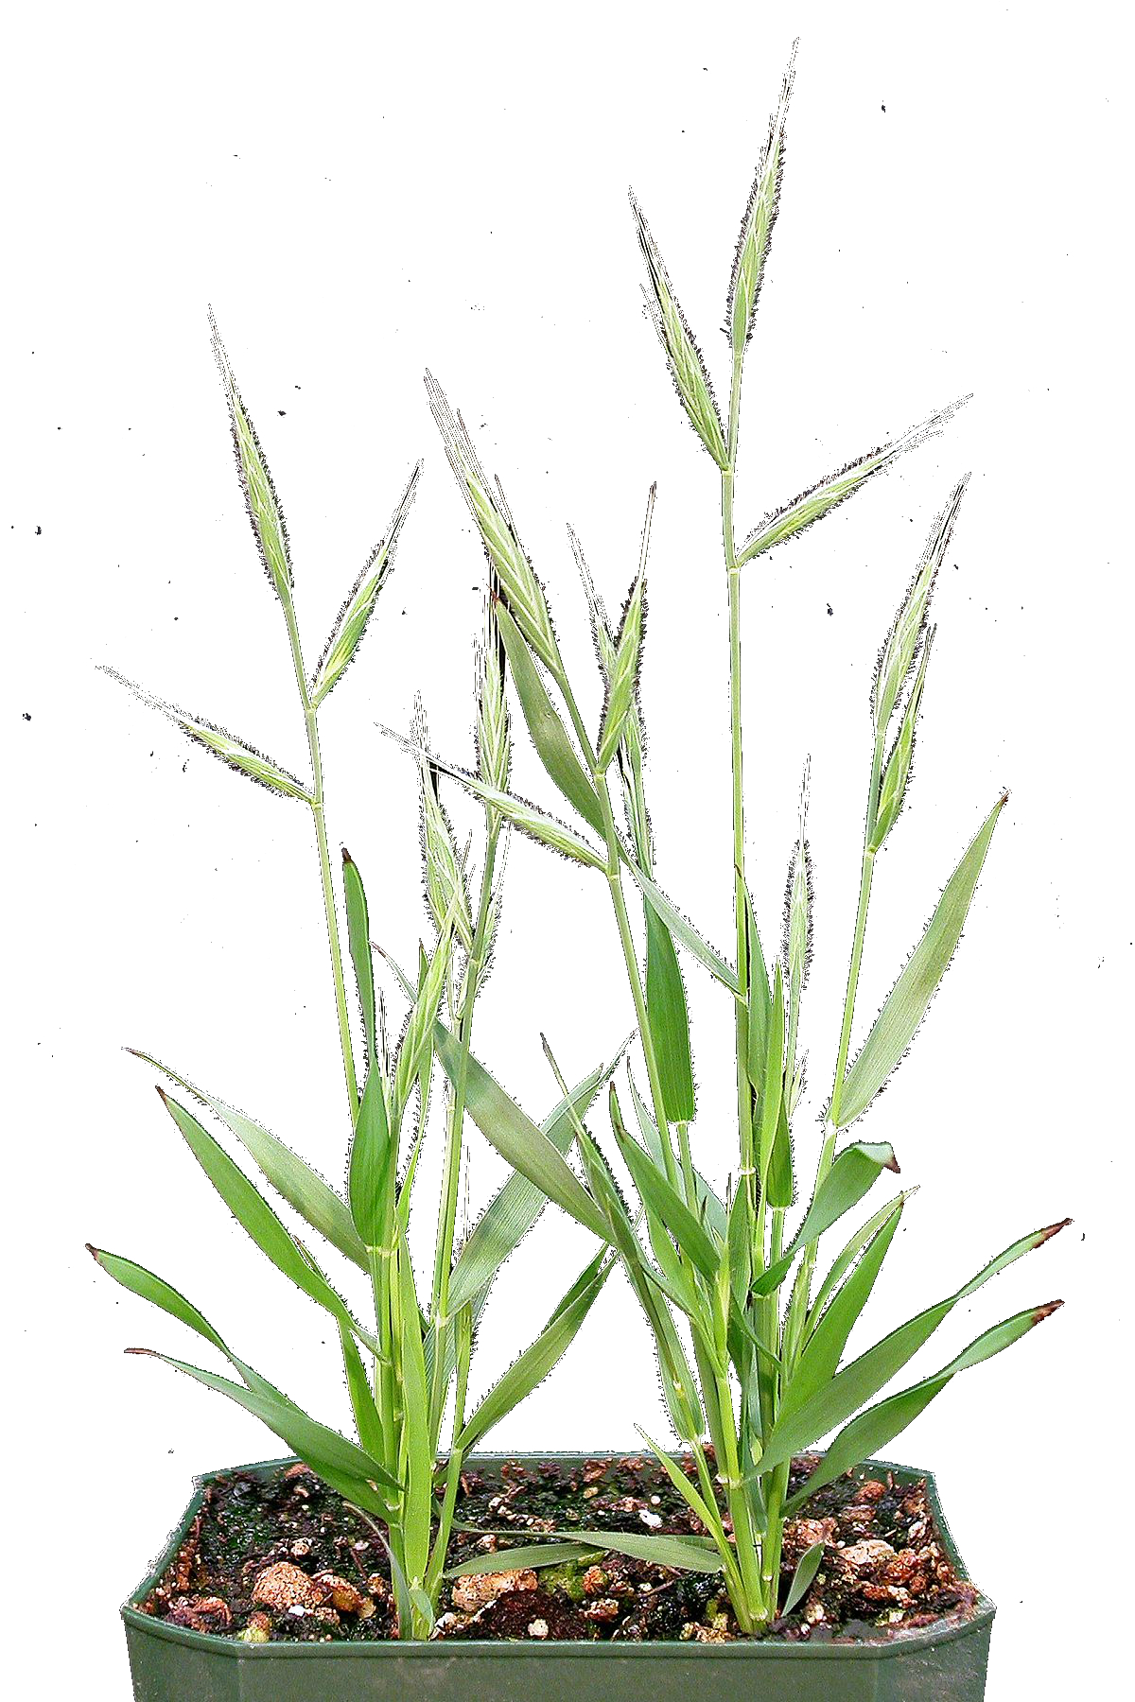
Identify terms over or under-represented in a set of genes: “in this list of genes, are there any functional classes that are found more often than expected when compared with the
reference list?”
https://www.arabidopsis.org
Powered by
http://www.pantherdb.org/

Slide 35
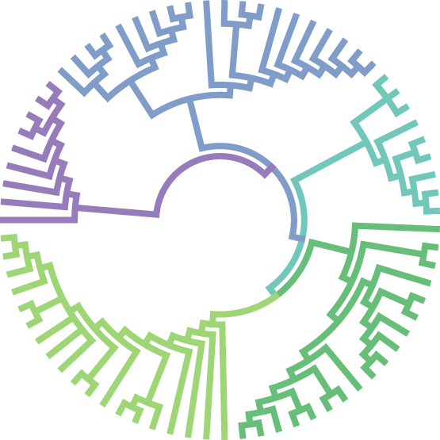
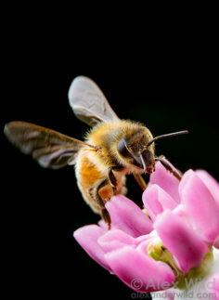
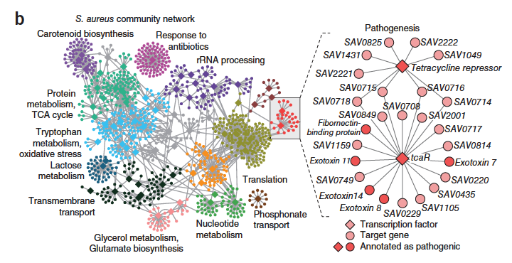
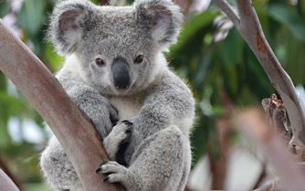
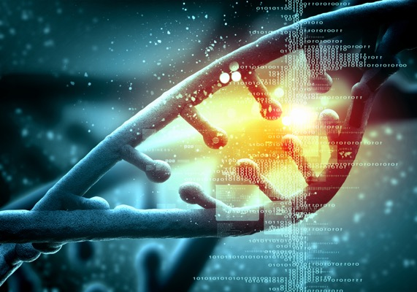
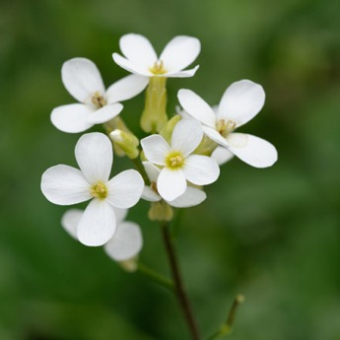
Comparing knowledge across species

Slide 36
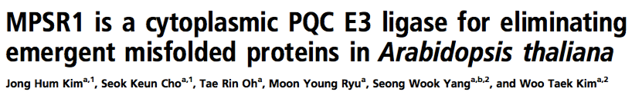
Exercise 1
www.pnas.org/cgi/doi/10.1073/pnas.1713574114
Based on the title we can assume that the paper includes experiments that demonstrate - molecular function (E3 ligase), - biological process (something about eliminating misfolded proteins), and - cellular localization (cytoplasm).
Notes:
possible paper(s):MPSR1 is a cytoplasmic PQC E3 ligase for eliminating emergent misfolded proteins in Arabidopsis thaliana (doi.org/10.1073/pnas.1713574114)
Biochemistry paper, easy, function, process, component, all pick the same term
Figure or table (capturing data points)
Highlight relevant information to extract
How do we put this information into GOAT? Show the association across gene to terms, etc.
If paper has been curated, show the final result in TAIR, AmiGO, etc.

Slide 37
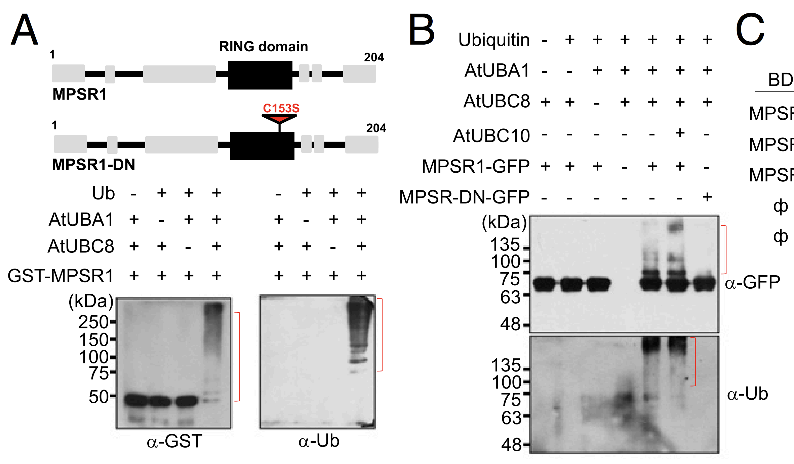
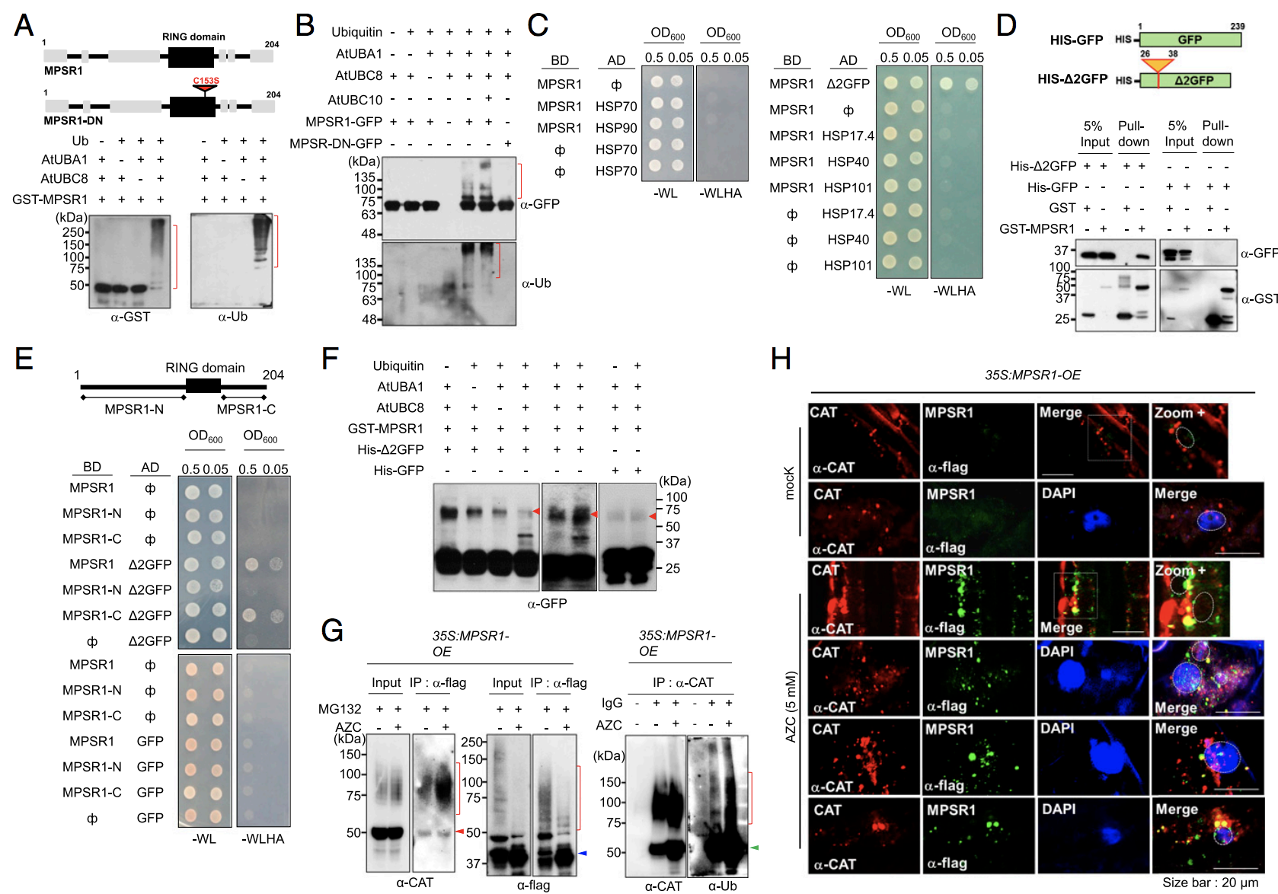
Assay for Molecular Function or Biological Role (Fig. 2)
Based on this figure/experiment: What can we say about the function of MPSR1, aka At1g26800 (AGI Identifier) or Q9LQX2 (UniProt ID)?
Notes:
Ubiquitin Ligase is a molecular activity- that is capable of performing this process of ubiquitination

Slide 38
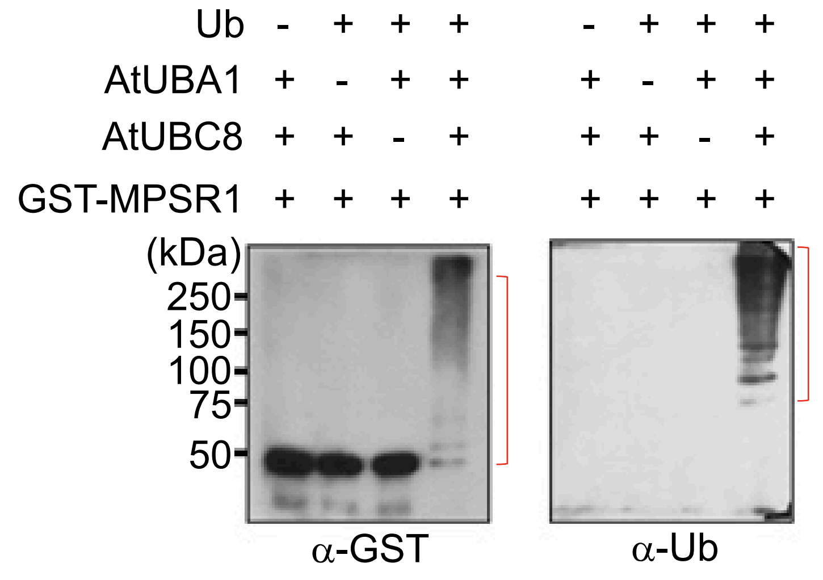
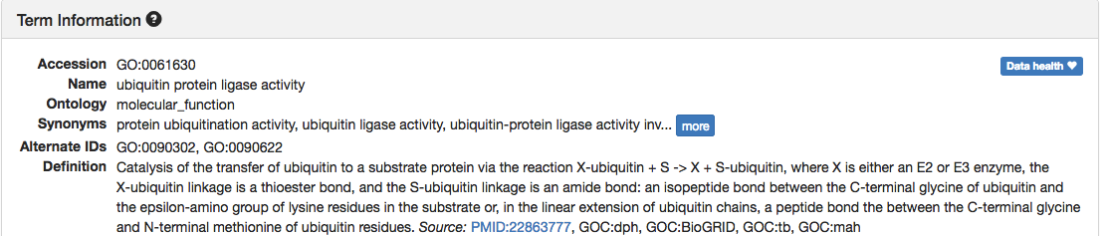

Assay for Molecular Function or Biological Role (Fig. 2)
Notes:
Ubiquitin Ligase is a molecular activity- what would be the evidence code?

Slide 39
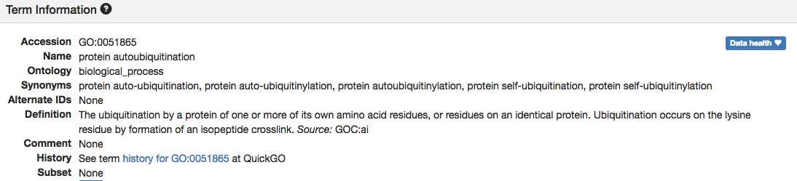
Assay for Molecular Function or Biological Role (Fig. 2)
Notes:
Ubiquitin Ligase is a molecular activity- that is capable of performing this process of ubiquitination

Slide 40
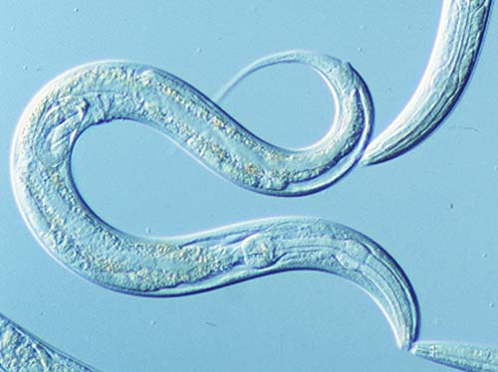

Exercise 2
Endogenous Nuclear RNAi Mediates Behavioral Adaptation to Odor
Juang et. al Cell - Volume 154, Issue 5, Pages 1010-1022 (August 2013) DOI: 10.1016/j.cell.2013.08.006
Copyright © 2013 Elsevier Inc. Terms and Conditions

Slide 41
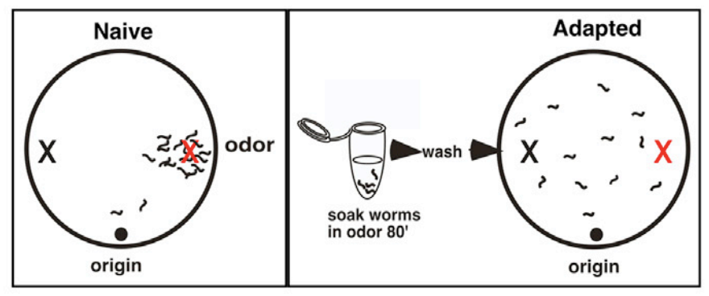
Somatic endogenous small interfering RNA pathway promotes odor adaptation in Caenorhabditis elegans AWC olfactory neurons
Argonaute NRDE-3 (which acts in AWC) is loaded with siRNAs that target odr-1; downregulation of odr-1 is required for adaptation.
Presence of siRNAs in odr-1 in AWC happens as HPL-2 binds at odr-1 locus in AWC, which causes decrease in odr-1 mRNAs.
Conclusion:
Environmental stimulation amplifies an endo-siRNA negative feedback loop to dynamically repress cognate gene expression and shape behavior.

Slide 42
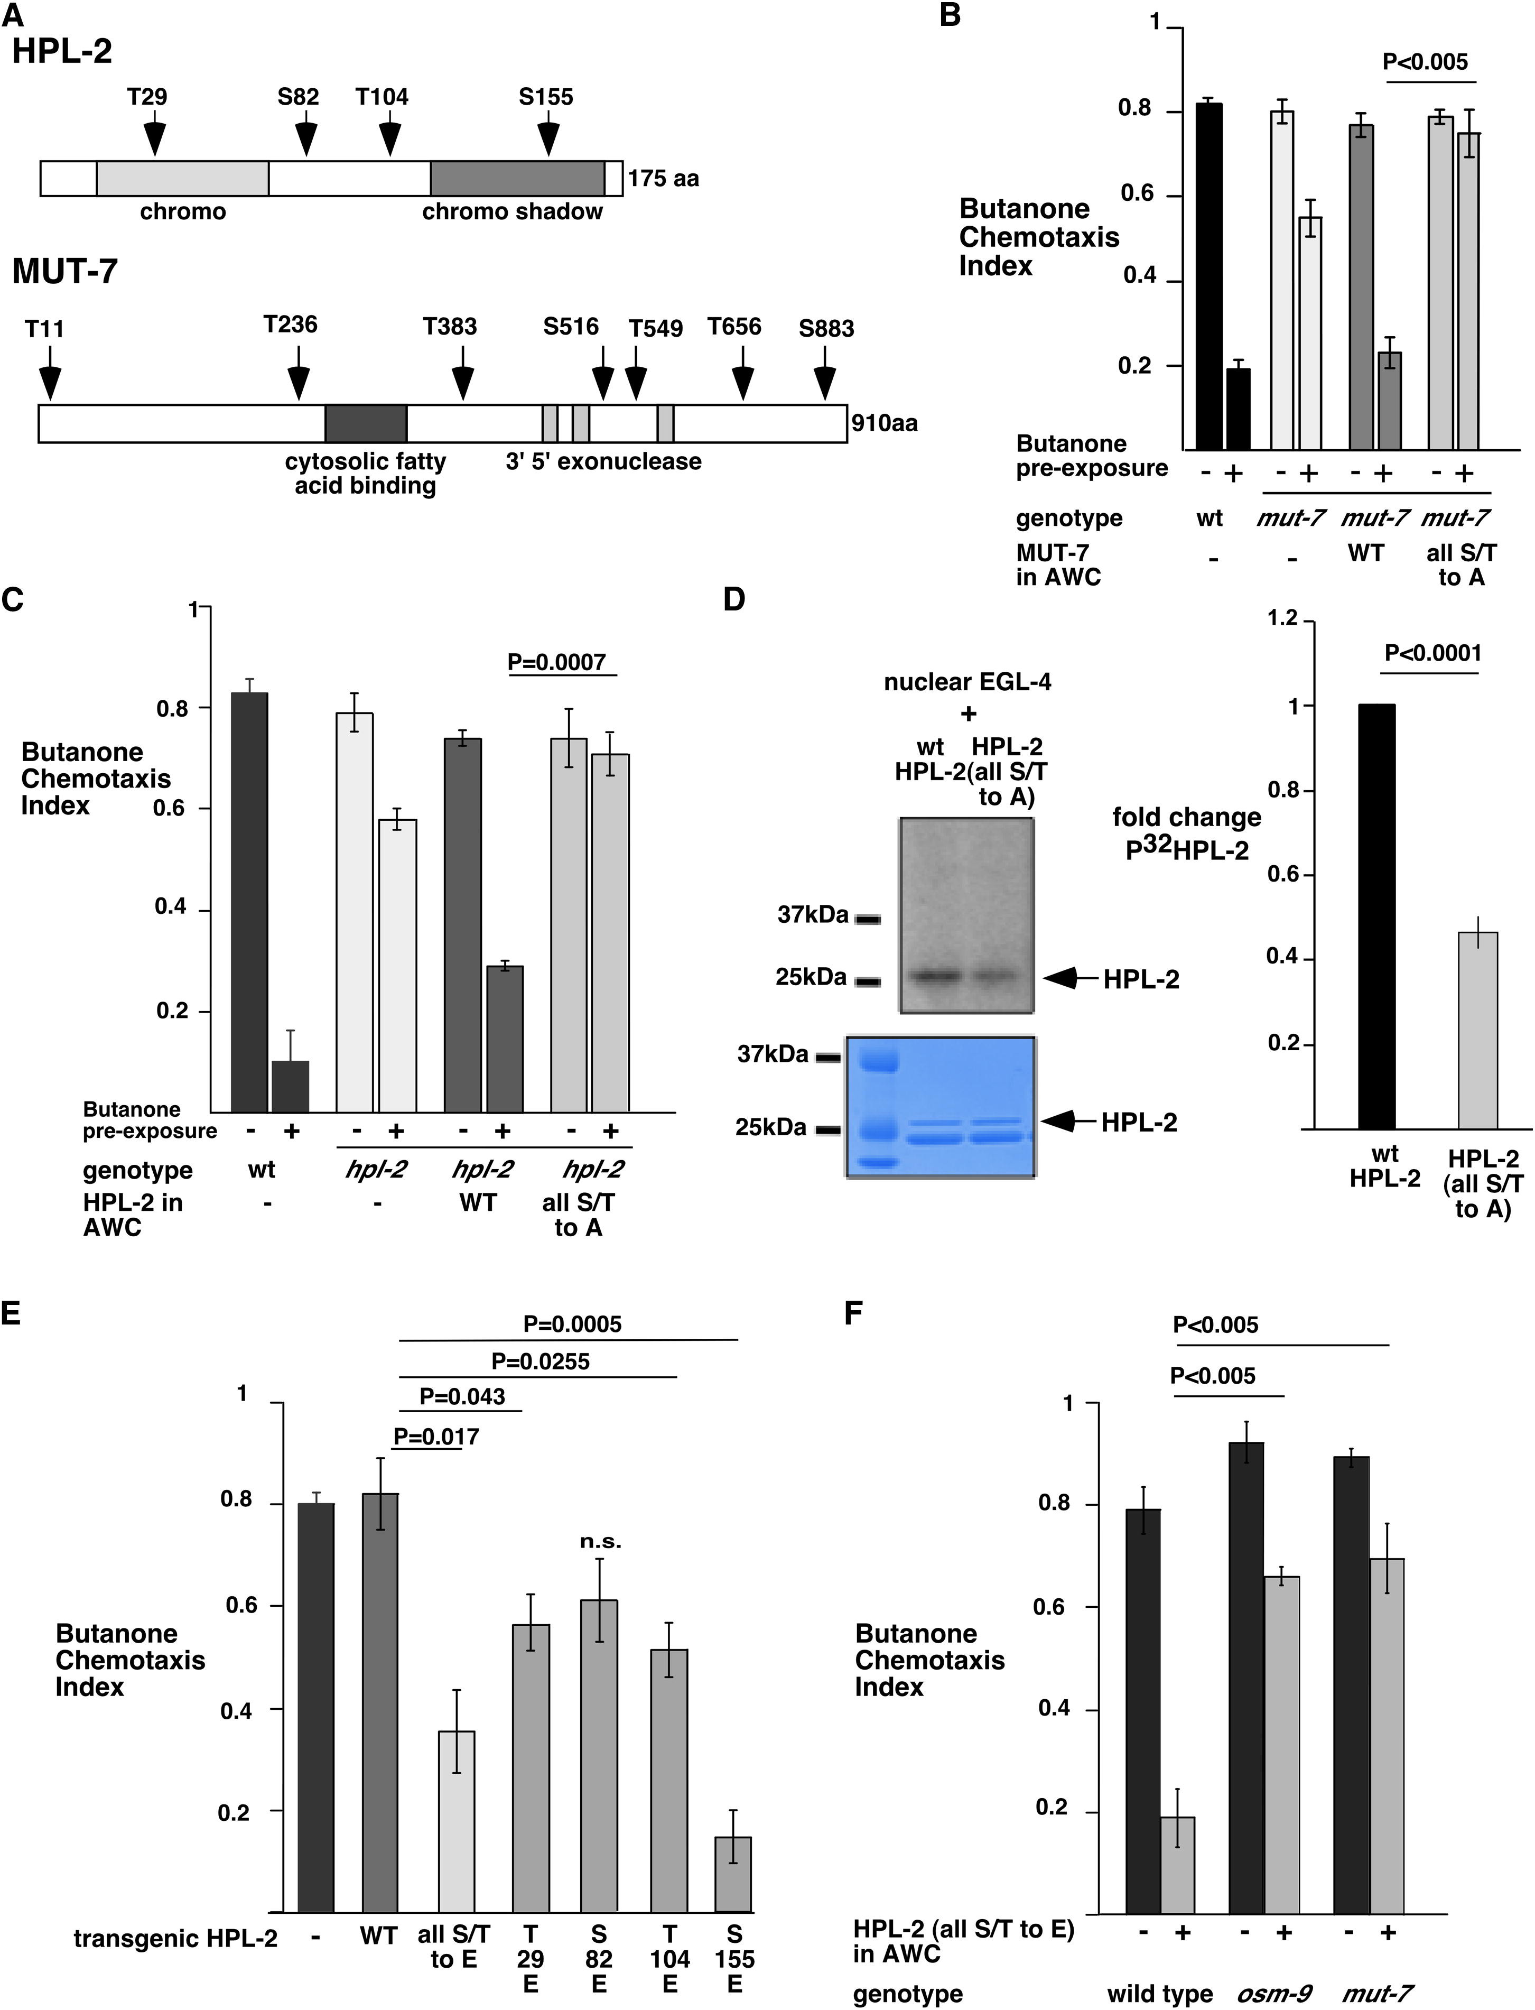
Figure 4. Phosphorylation of MUT-7 (B) and HPL-2 (C) at predicted PKG sites (A) is required for adaptation. It also reduces butanone chemotaxis (E) and promotes adaptation (F) to odor in wt animals.
Cell 2013 154, 1010-1022DOI: (10.1016/j.cell.2013.08.006)
Copyright © 2013 Elsevier Inc.
Notes:
Phosphorylation of HPL-2 and MUT-7 at Predicted PKG Sites Is Required for Adaptation
(A) Schematic of HPL-2 and MUT-7. (Top) HPL-2 contains an N-terminal chromodomain, a C-terminal chromo shadow domain, and four predicted PKG phosphorylation sites. (Bottom) MUT-7 contains two predicted functional domains—cytosolic fatty acid binding domain and 3′ to 5′ exonuclease—and seven predicted PKG phosphorylation sites.
(B) Phosphorylation of predicted PKG target sites in MUT-7 is required for adaptation. Mean CIs of wild-type or mut-7(pk204) strains expressing the indicated form of MUT-7 in AWC. Figure S3D shows individual lines. n = 3 and p value is from a two-tailed Student’s t test. The lines rescued the sterility defects of mut-7(pk204) (Figure S3B).
(C) Phosphorylation of HPL-2 at predicted PKG sites is required for adaptation. CIs of animals of the indicated genotype that expressed the indicated form of HPL-2 cDNA in AWC are shown. n > 3 with >100 individuals per assay. p value is from an unpaired Student’s t test.
(D) Nuclear EGL-4 phosphorylates HPL-2 in vitro. (Left) 3XFLAG-nuclear EGL-4 kinase was immunopurified from worms (behavior in Figure S3F) and incubated with purified HPL-2 and ³²P ATP. The reactions were resolved on a gel and stained with Coomassie blue as loading control (lower) followed by autoradiography (upper). (Right) Quantification of five independent kinase assays. ³²P phosphorylated HPL-2 was normalized to Coomassie stained band. Values shown for mutant HPL-2 substrate are shown as fold reduction of phosphorylation relative to HPL2-wild-type, which was set to 1. Error bars represent mean ± SEM (p < 0.0001; two-tailed Student’s t test, n = 5).
(E) Phosphorylation of HPL-2 at a predicted PKG phosphorylation site in the CSD is sufficient to decrease butanone chemotaxis in naive animals. CIs of wild-type animals expressing the indicated form of HPL-2 in AWC, n > 3. Figure S3E shows CIs of individual lines. All strains expressed similar levels of the indicated transgenes as assessed by GFP intensity. p values are from a two-tailed Student’s t test.
(F) Phosphorylation of HPL-2 at the EGL-4 phosphorylated sites is sufficient to promote adaptation in naive animals. CIs of naive wild-type, osm-9, or mut-7 animals either expressing the phosphomemetic HPL-2(S/Tto E) (+) or not (−). In all panels of this figure, the bars represent the mean values, and the error bars represent SEM; n > 5. p value is from an unpaired two-tailed Student’s t test.

Slide 43
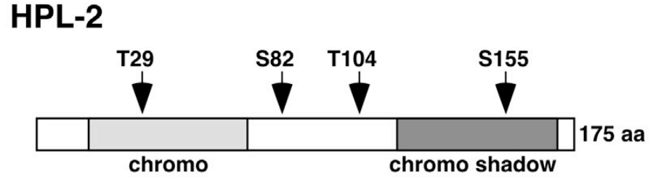
Figure 4
All serines (S) and threonines(T) replaced with glutamic acid (A), which is phophomimetic.
(D)
Prolonged odor stimulation causes nuclear accumulation of EGL-4.
Nuclear EGL-4 phosphorylates HPL-2 in vitro. EGL-4 kinase was immunopurified from worms and incubated with purified HPL-2 and 32P ATP.
Conclusion: Phosphorylation of HPL-2 at the EGL-4 phosphorylated sites is sufficient to promote adaptation in naive animals.
Coomassie blue as loading control (lower) followed by autoradiography (upper).
Cell 2013 154, 1010-1022DOI: (10.1016/j.cell.2013.08.006)
Copyright © 2013 Elsevier Inc. Terms and Conditions
Notes:
Phosphorylation of HPL-2 and MUT-7 at Predicted PKG Sites Is Required for Adaptation
(A) Schematic of HPL-2 and MUT-7. (Top) HPL-2 contains an N-terminal chromodomain, a C-terminal chromo shadow domain, and four predicted PKG phosphorylation sites. (Bottom) MUT-7 contains two predicted functional domains—cytosolic fatty acid binding domain and 3′ to 5′ exonuclease—and seven predicted PKG phosphorylation sites.
(B) Phosphorylation of predicted PKG target sites in MUT-7 is required for adaptation. Mean CIs of wild-type or mut-7(pk204) strains expressing the indicated form of MUT-7 in AWC. Figure S3D shows individual lines. n = 3 and p value is from a two-tailed Student’s t test. The lines rescued the sterility defects of mut-7(pk204) (Figure S3B).
(C) Phosphorylation of HPL-2 at predicted PKG sites is required for adaptation. CIs of animals of the indicated genotype that expressed the indicated form of HPL-2 cDNA in AWC are shown. n > 3 with >100 individuals per assay. p value is from an unpaired Student’s t test.
(D) Nuclear EGL-4 phosphorylates HPL-2 in vitro. (Left) 3XFLAG-nuclear EGL-4 kinase was immunopurified from worms (behavior in Figure S3F) and incubated with purified HPL-2 and ³²P ATP. The reactions were resolved on a gel and stained with Coomassie blue as loading control (lower) followed by autoradiography (upper). (Right) Quantification of five independent kinase assays. ³²P phosphorylated HPL-2 was normalized to Coomassie stained band. Values shown for mutant HPL-2 substrate are shown as fold reduction of phosphorylation relative to HPL2-wild-type, which was set to 1. Error bars represent mean ± SEM (p < 0.0001; two-tailed Student’s t test, n = 5).
(E) Phosphorylation of HPL-2 at a predicted PKG phosphorylation site in the CSD is sufficient to decrease butanone chemotaxis in naive animals. CIs of wild-type animals expressing the indicated form of HPL-2 in AWC, n > 3. Figure S3E shows CIs of individual lines. All strains expressed similar levels of the indicated transgenes as assessed by GFP intensity. p values are from a two-tailed Student’s t test.
(F) Phosphorylation of HPL-2 at the EGL-4 phosphorylated sites is sufficient to promote adaptation in naive animals. CIs of naive wild-type, osm-9, or mut-7 animals either expressing the phosphomemetic HPL-2(S/Tto E) (+) or not (−). In all panels of this figure, the bars represent the mean values, and the error bars represent SEM; n > 5. p value is from an unpaired two-tailed Student’s t test.

Slide 44
Basic GO Annotation Model
Entity – GO ID/Term – Evidence Code – Reference
Protein: EGL-4
GO:0009299
cGMP-dependent
protein kinase activity
Inferred from Direct Assay
(IDA)
PMID:23993094

Slide 45
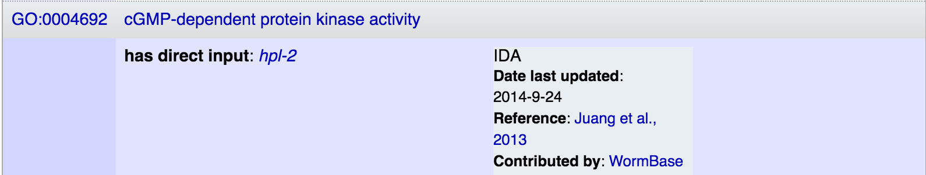
At Wormbase:
https://wormbase.org/species/c_elegans/gene/WBGene00001173#03-9g-3

Slide 46
There are multiple data entry tools
Different from resource to resource
Same basic features, varying amounts of quality control
Same output for sharing. For example, GO has GAF and GPAD formatted files.

Slide 47
To Keep in Mind
When making functional annotations for genes:
Choose primary research articles, not reviews
Verify experimental design, organism, and results
Find the identifier for the gene(s) in question in the paper
Look at the results section, aim for the figures and tables
Use the most granular terms possible
Notes:
What to look for in a paper? What makes a paper *good* for functional curation?…… e.g. understanding if / when to annotate phenotypesNOT high throughput papers!

Slide 48
To Keep in Mind
When writing manuscripts:
Clearly identify organism(s) and gene identifiers.
Use existing gene nomenclature, otherwise check with your species database on naming conventions.
Identify versions of bioinformatics tools used as well as the versions of the data used in the analysis, if this applies.
Verify information in reference databases- contact someone if there are errors/omissions.
Notes:
What to look for in a paper? What makes a paper *good* for functional curation?…… e.g. understanding if / when to annotate phenotypesNOT high throughput papers!

Slide 49
Exercise 3
Find an interesting recent paper to annotate
PubMed
Research article NOT a review
Find the UniProt ID or other identifier for the gene

Slide 50
One more example. . .

Slide 51
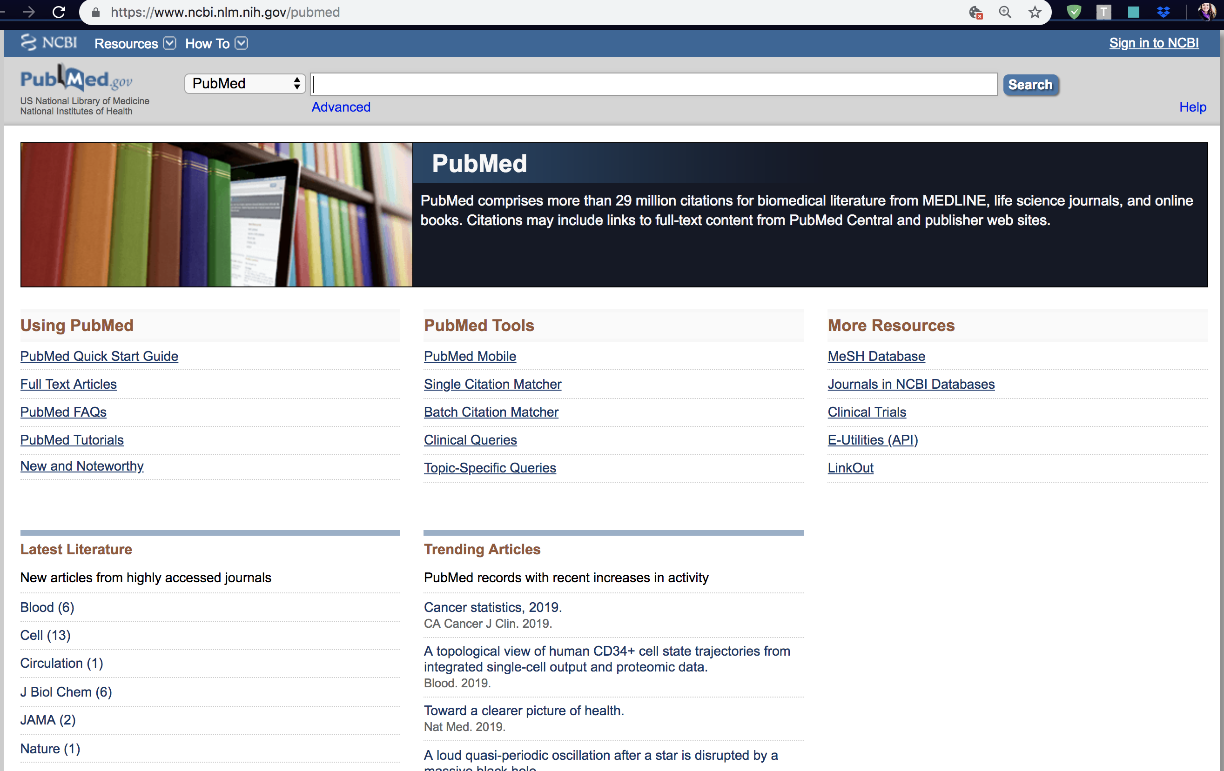

Slide 52
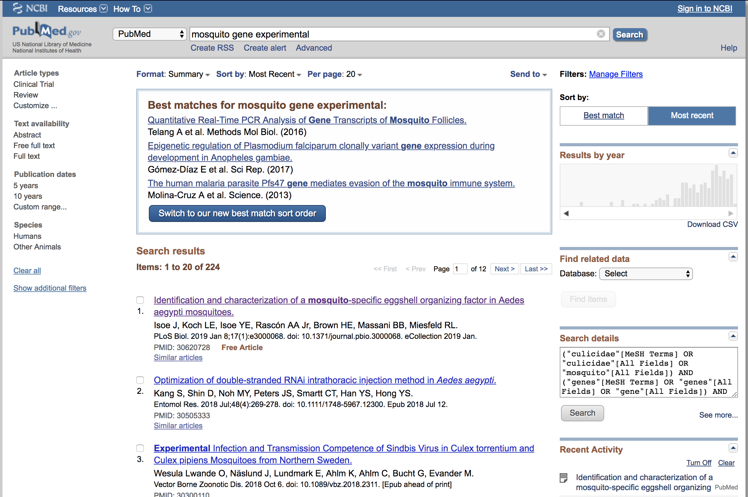

Slide 53
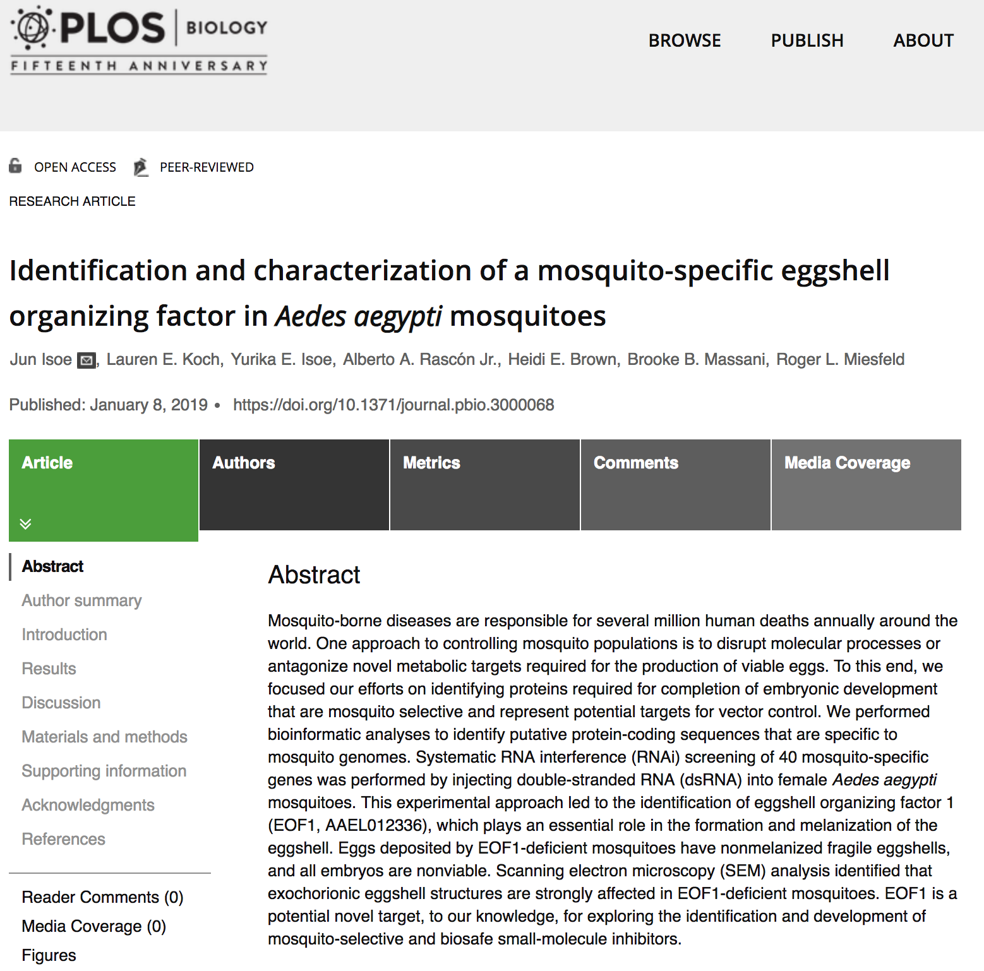

Slide 54


Slide 55


Fig 1. Egg phenotypes associated with EOF1 gene suppression by RNAi in A. aegypti mosquitoes.
Isoe J, Koch LE, Isoe YE, Rascón AA Jr, Brown HE, et al. (2019) Identification and characterization of a mosquito-specific eggshell organizing factor in Aedes aegypti mosquitoes. PLOS Biology 17(1): e3000068. https://doi.org/10.1371/journal.pbio.3000068 https://journals.plos.org/plosbiology/article?id=10.1371/journal.pbio.3000068

Slide 56


Slide 57

Fig 3. Spatial distribution and expression level of EOF1 during the first gonotrophic cycle in A. aegypti.
Isoe J, Koch LE, Isoe YE, Rascón AA Jr, Brown HE, et al. (2019) Identification and characterization of a mosquito-specific eggshell organizing factor in Aedes aegypti mosquitoes. PLOS Biology 17(1): e3000068. https://doi.org/10.1371/journal.pbio.3000068 https://journals.plos.org/plosbiology/article?id=10.1371/journal.pbio.3000068

Slide 58


Slide 59
Training Materials
Articles for annotation exercises and slides from this presentation can be found at:
http://bit.ly/phoenix-pag-2019

